Slide 1
Predicting Transportation
Demand

Slide 2
Need for Prediction
Shorter wait time increases customer satisfaction
On hand drivers and vehicles increases customer base
More customers means less down time for drivers
Less down time leads to higher profit and less overhead

Slide 3
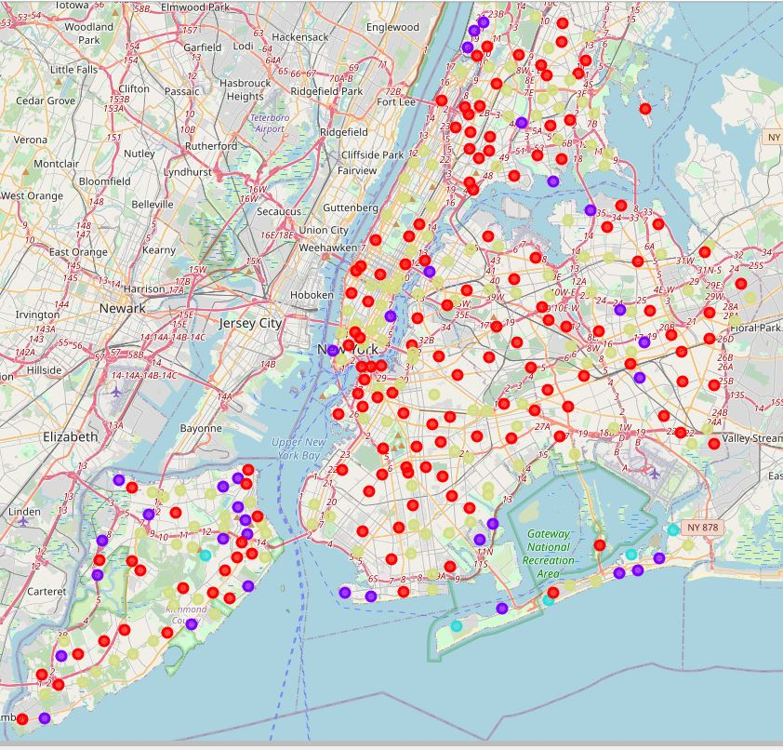
New York Neighborhoods

Slide 4
Clustering Neighborhoods
Categorizing neighborhoods by venue types allows predictions for demand
Certain venues typically have high traffic flows at predictable times
Understanding traffic flow trends allows for prediction of demand in order to adjust supply

Slide 5
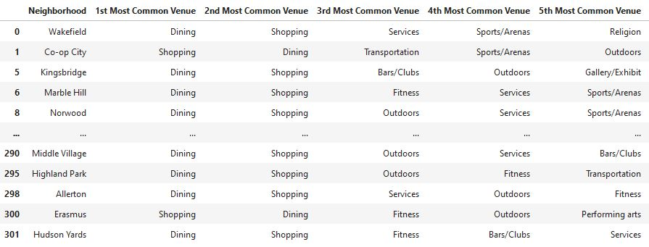
Cluster 1

Slide 6
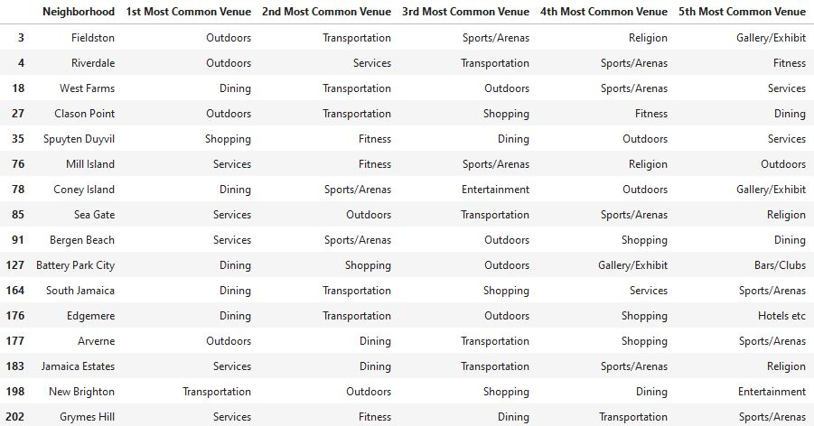
Cluster 2

Slide 7
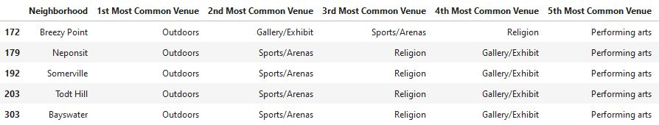
Cluster 3

Slide 8
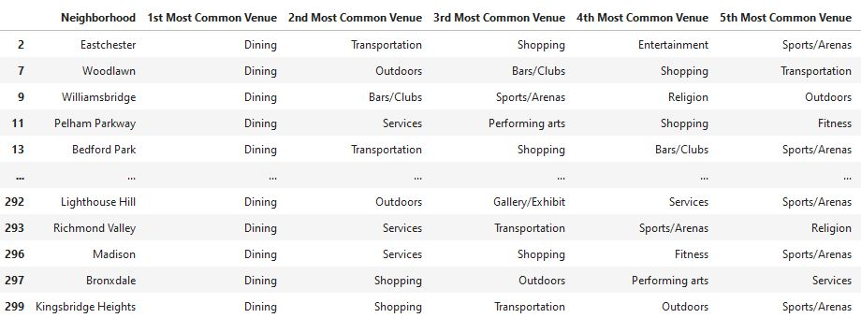
Cluster 4

Slide 9
Likely Peak Demand
Cluster 1: Afternoon-Early Evening
Cluster 2: During major events and weather that promotes outdoor activity
Cluster 3: Low demand outside of major events
Cluster 4: Evening to very early morning

